Slide 1
Organ Donation Management System
Presentation by:
Amol Mogare.
Harshal Wagh.

Slide 2
Introduction :
The organ donation management system involves a web-based platform that collects the information of organs of donors as well as patients. This system manages the emergency request for organs based on the location of both the donor and the patient and other medical information . it is up to the administration to update and remove records if necessary . the fundamental concept of this management system is to transform a complicated and time consuming process into one that is effortless and secure.

Slide 3
Need Of the System :
To promote organ donation for transplantation as a treatment for many life-threatening diseases including heart disease, kidney disease, liver disease, diabetes, and cystic ﬁbrosis
To educate and inform the community, patients and their families, and health professionals about organ and tissue donation to markedly improve rates of donation.
To work in partnership with the Department of Health (DOH), clinicians, and hospitals to promote best practice professional training and ensure that the family of every potential donor is oﬀered the option of donation in a caring and respectful manner.
To provide support, care, information, and advocacy for people with end stage organ failure, donor families, living donors transplant recipients, and their families.
To provide policy advice to DOH, clinicians, and hospitals.
Assuring compliance with all external regulatory bodies, including but not limited to: the Organ Procurement and Transplantation Network (OPTN), the United Network for Organ Sharing (UNOS), Centers for Medicare and Medicaid Services (CMS) Conditions of Participation (COP), the Missouri State Department of Health (DOH), The Joint Commission (TJC) Standards

Slide 4
Ensuring the program’s accreditation
Identifying opportunities for improvement
Prioritizing performance improvement and patient safety projects within organ transplantation
Continuously audit compliance and regulatory standards related to organ transplantation
Ensuring policies and procedures applicable to organ transplantation are evidence based, regularly reviewed and audited for compliance.

Slide 5
Actors and Functions:
Admin:
Admin can delete, manage Donor/Patient as per review
Donor:
Donor register as per his role at the time of registration.
Then using his username and password he can login in the system.
After successful login he have to fill the form .
He must fill the right information about his medical and residential details.
After all process he can see the information about beneficiary.

Slide 6
Patient:
patient register as per his role at the time of registration.
Then using his username and password he can login in the system.
After successful login he have to fill the form .
He must fill the right information about his medical and residential details.
After all process he can see the information about beneficiary.

Slide 7
Technology Used:
Front End: ReactJs
Data-Base :MySQL
Back End: Java Spring Boot API.

Slide 8
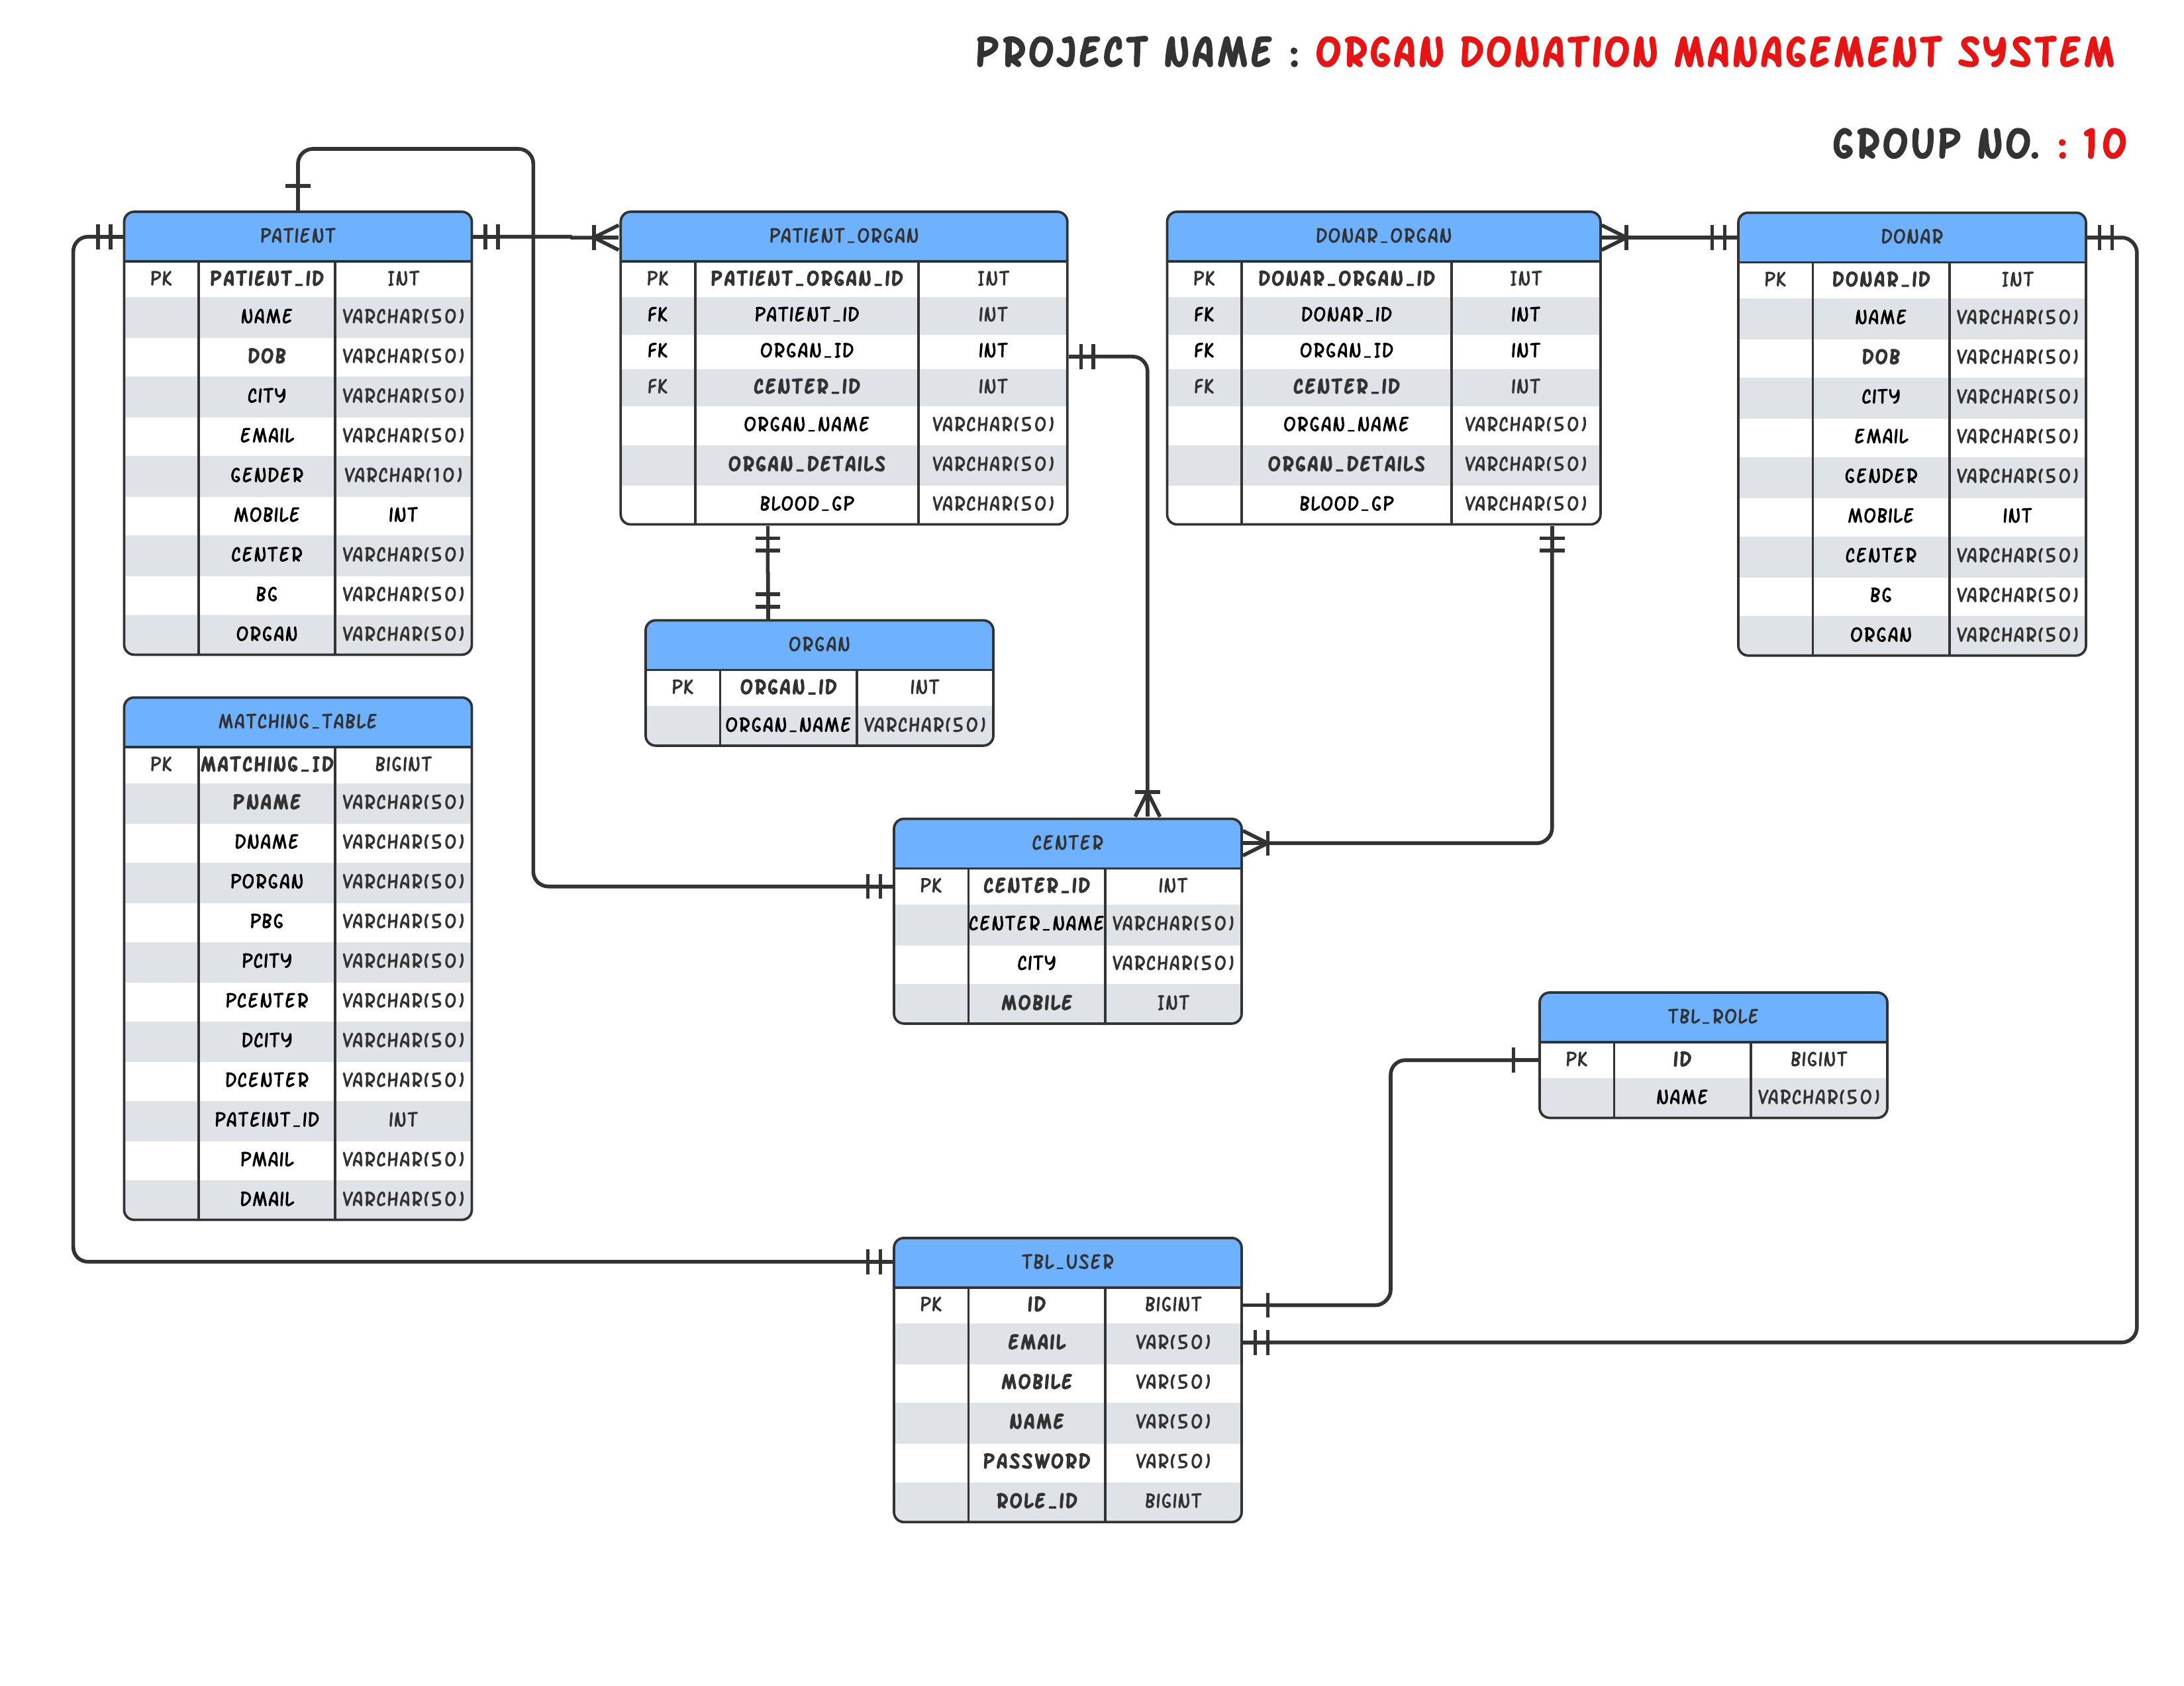
Entity Relationship Diagram

Slide 9
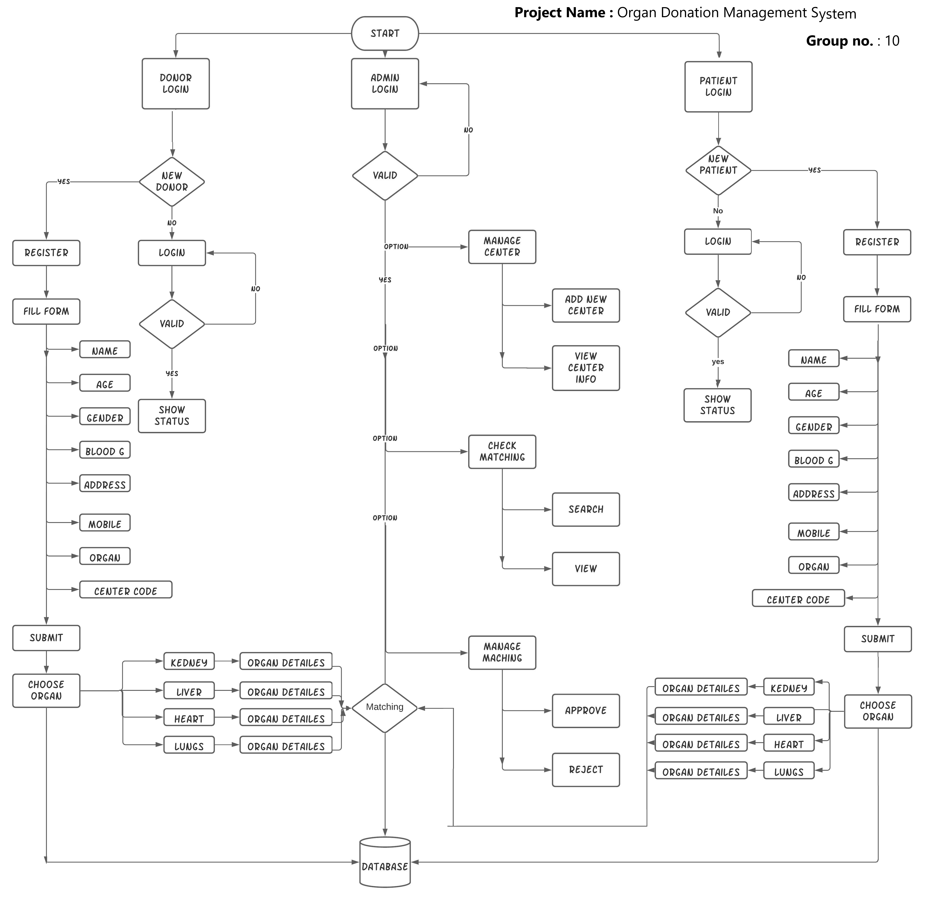
Flow chart :

Slide 10
Screenshots

Slide 11
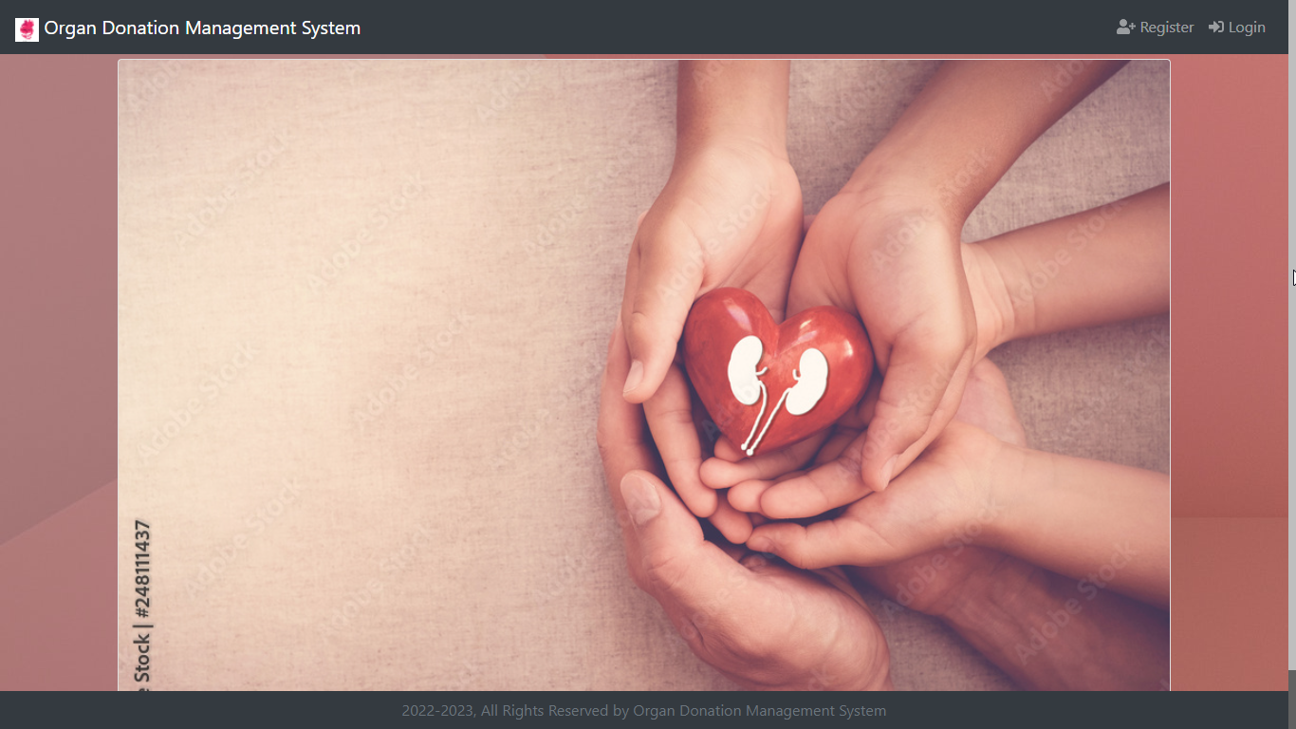
Home Page

Slide 12
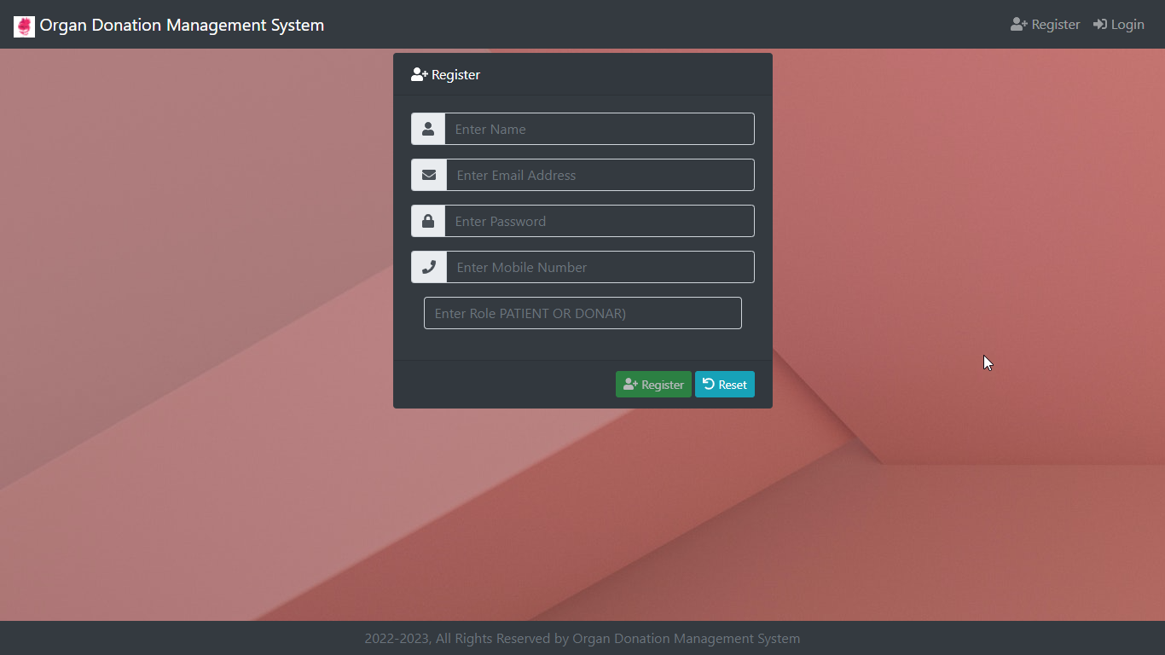
Register Page

Slide 13
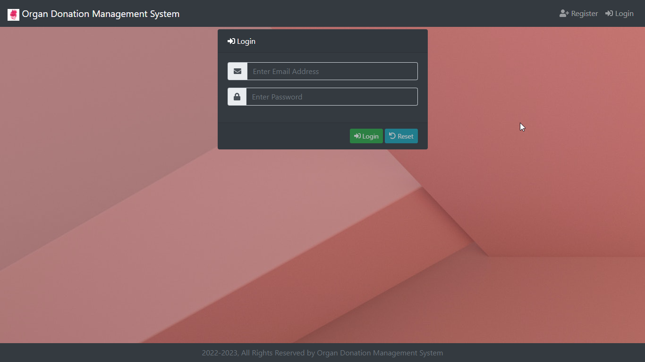
Login Page

Slide 14
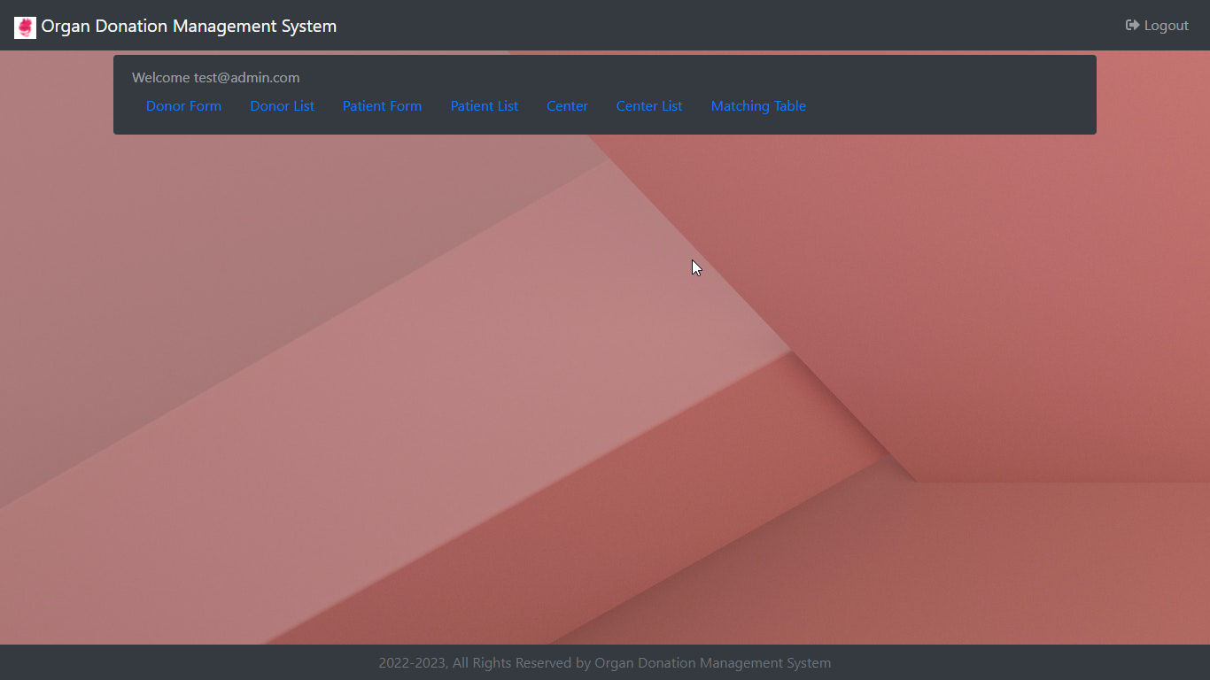
Admin Page

Slide 15
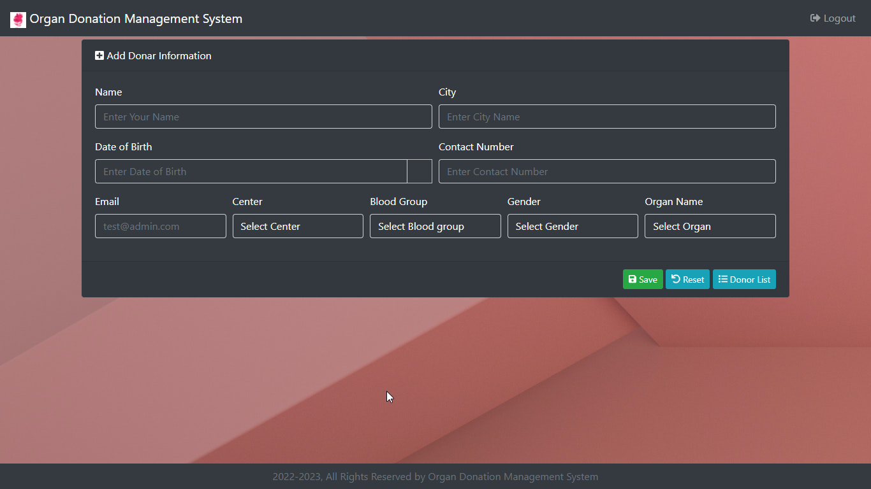
Admin Donor Page

Slide 16
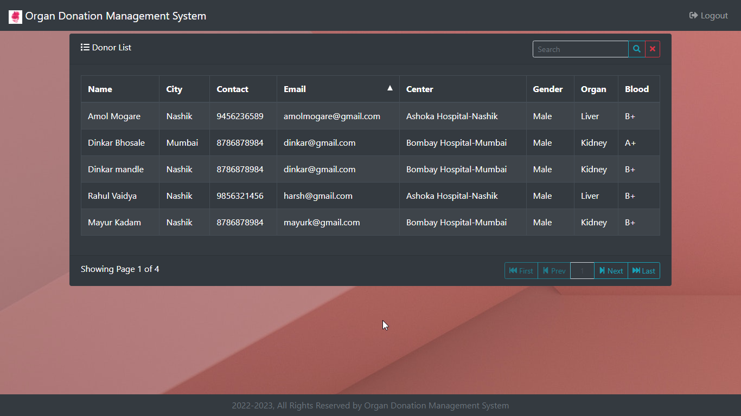
Admin DonorList Page

Slide 17
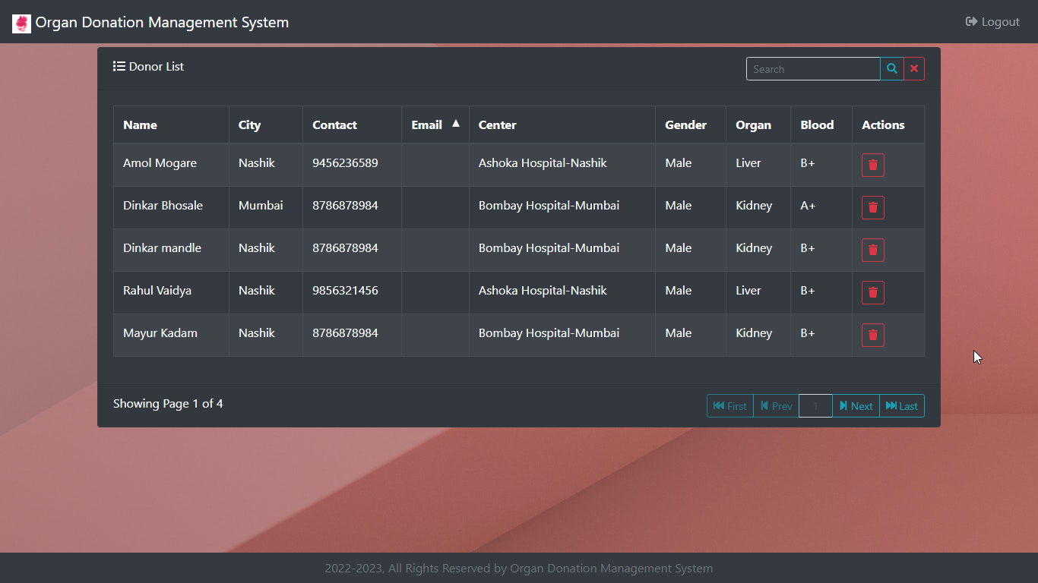
Admin Donor controllable Page

Slide 18

Patient Page

Slide 19
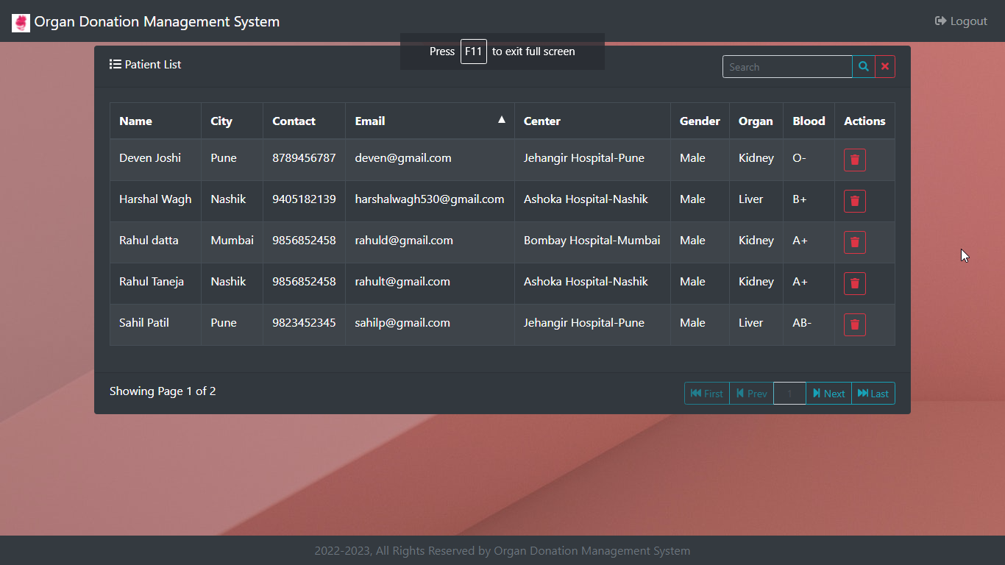
Patient List Page

Slide 20

Patient List Page

Slide 21
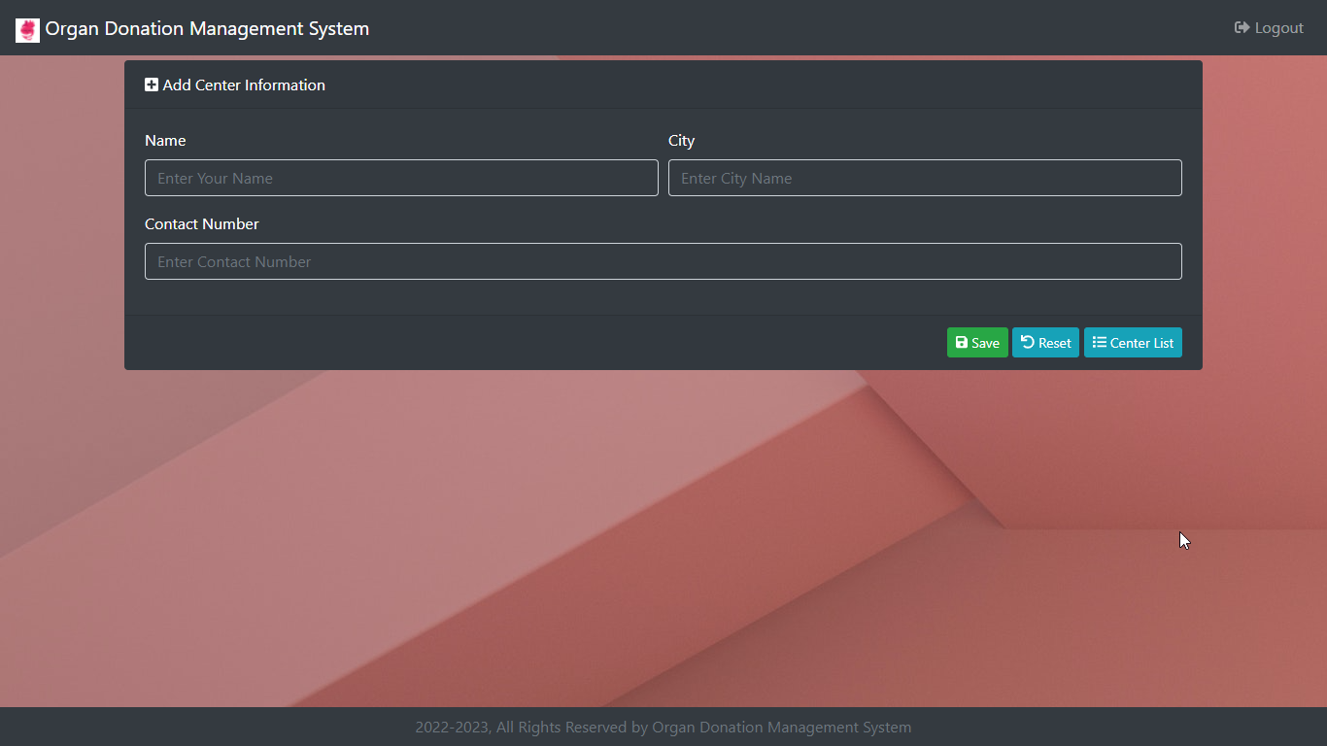
Center Form Page

Slide 22
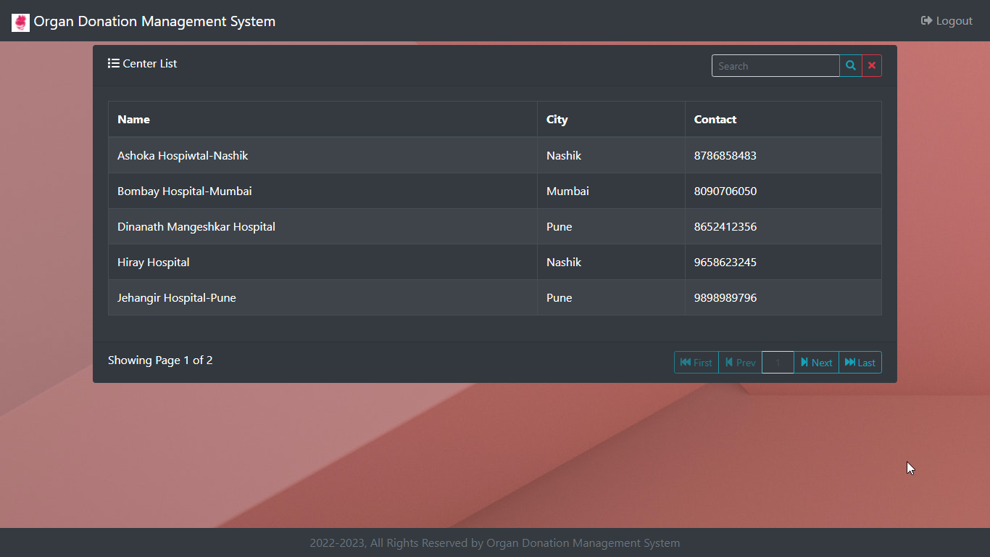
Center List Page

Slide 23
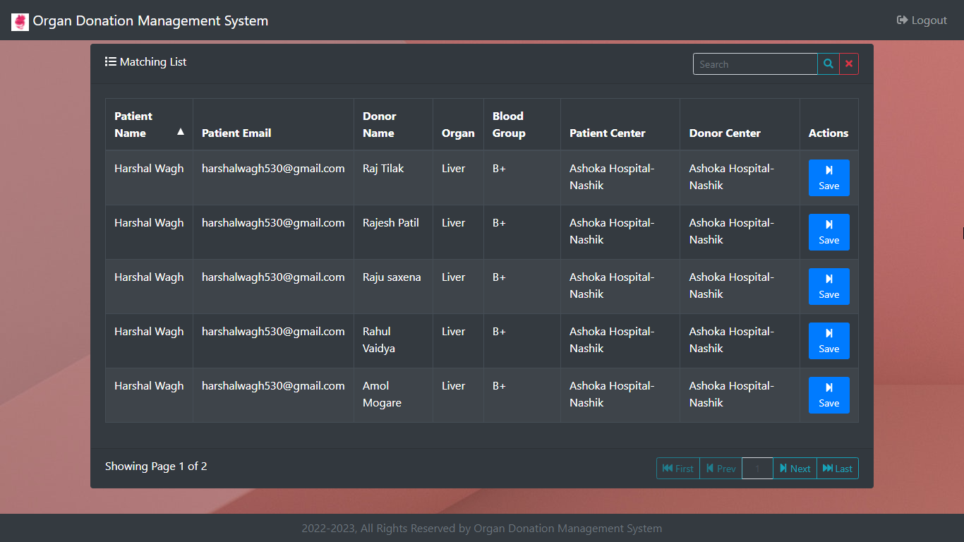
Matching controller Page

Slide 24
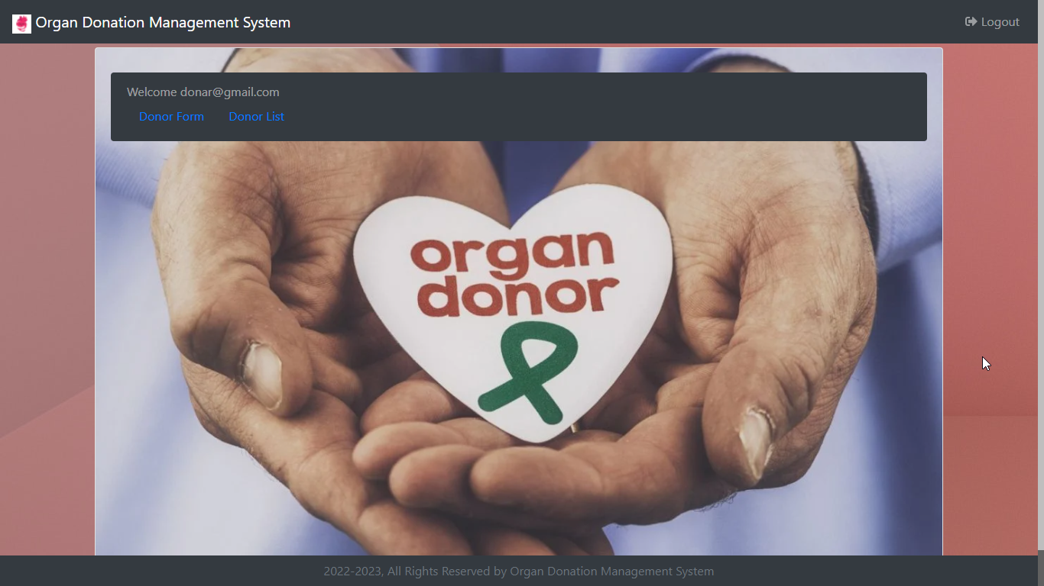
Donor Home Page

Slide 25

Donor form Page

Slide 26

Donor List Page

Slide 27
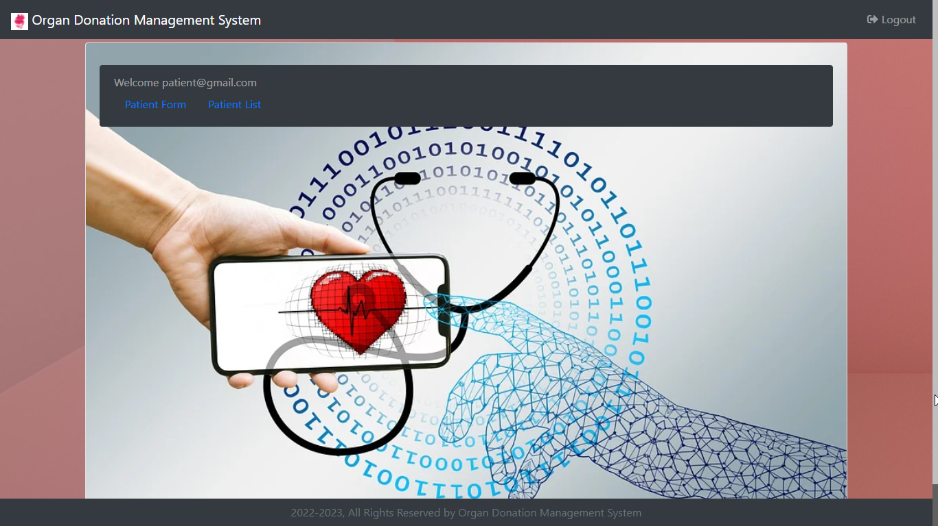
Patient Home Page

Slide 28

Patient form Page

Slide 29
Patient List Page

Slide 30
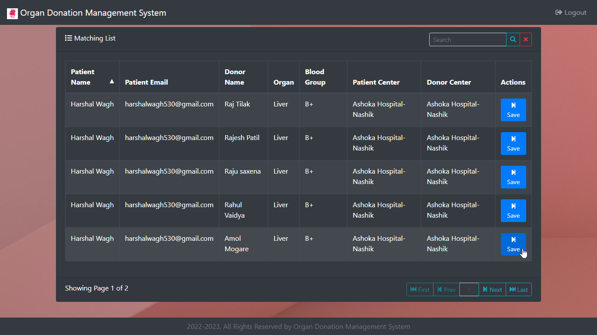
Notify to Patient by clicking save

Slide 31
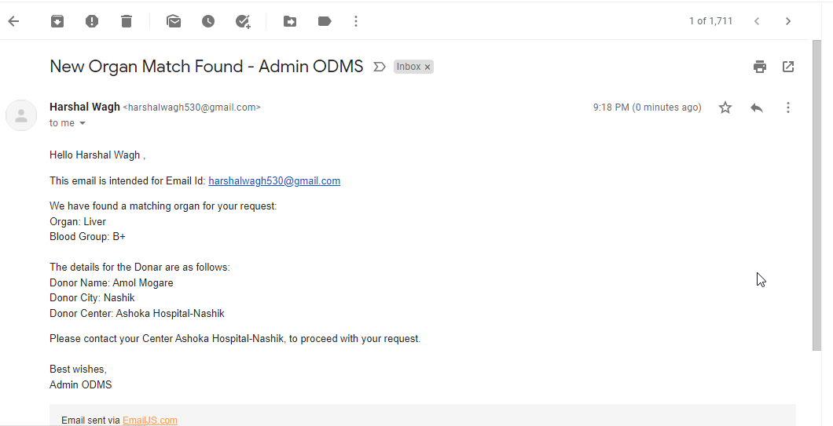
Mail sent to patient

